Slide 1
AVACADO PROJECT

Slide 2
Problem Statement:
Avocado is a fruit consumed by people heavily in the United States.
Content
This data was downloaded from the Hass Avocado Board website in May of 2018 & compiled into a single CSV.
The table below represents weekly 2018 retail scan data for National retail volume (units) and price. Retail scan data comes directly from retailers’ cash registers based on actual retail sales of Hass avocados.
Starting in 2013, the table below reflects an expanded, multi-outlet retail data set. Multi-outlet reporting includes an aggregation of the following channels: grocery, mass, club, drug, dollar and military. The Average Price (of avocados) in the table reflects a per unit (per avocado) cost, even when multiple units (avocados) are sold in bags.
The Product Lookup codes (PLU’s) in the table are only for Hass avocados. Other varieties of avocados (e.g., green skins) are not included in this table.

Slide 3
Some relevant columns in the dataset:
Date - The date of the observation
Average Price - the average price of a single avocado
type - conventional or organic
year - the year
Region - the city or region of the observation
Total Volume - Total number of avocados sold
4046 - Total number of avocados with PLU 4046 sold
4225 - Total number of avocados with PLU 4225 sold
4770 - Total number of avocados with PLU 4770 sold

Slide 4
1.Problem Definition:
Avocado price data includes observations from 2015 to 2018 and was originally extracted from Avacado project and downloaded the dataset covers the .csv files average prices, types (conventional or organic), and cities and regions where avocados were sold. The goal is to predict the average price which is continuous in nature of the different type of avocado and using the region that in which region they are lying.

Slide 5
2. Data Analysis:
Data Preparation and Cleaning
Reading the CSV file and doing initial statistical analysis (shape, values etc)
Data Pre-processing: Reading the unique values for each column and removing
those which won’t be significant in the analysis further.
Create a new data frame to proceed with the analysis further
Dataset contains
Date — The date of the observation
Average Price — the average price of a single avocado
type — conventional or organic
year — the year
Region — the city or region of the observation
Total Volume — Total number of avocados sold
4046 — Total number of avocados with PLU 4046 sold
4225 — Total number of avocados with PLU 4225 sold
4770 — Total number of avocados with PLU 4770 sold

Slide 6
This project is based on a hypothetical dataset downloaded from Avacado project it
has 1,517 data points (rows) and 35 features (columns) describing each fruit background
and characteristics; and labelled (supervised learning) with whether they are still in the
company or whether they have gone to work somewhere else. Machine Learning models
can help to understand and determine how these factors relate to workforce attrition
I had a hypothesis of demand and supply, which means, in other words, that if the consumed
volumes are higher, then the prices would be lower. The scatter plot I created, using matplotlib
in Python libraries displays that it seems there is a trend for that direction. The Pearson
correlation coefficient showed a small negative correlation between the average price and
average volume consumption. Thus, there is an association between demand and supply, but
that cannot explain everything about how the prices are structured. Having some outliers on the
right side of the plot where some cities had the highest prices while the consumed volumes are
limited. The correlation between different features of the dataset showed that employees with
low satisfaction level left. The correlation heat map is shown below:

Slide 7
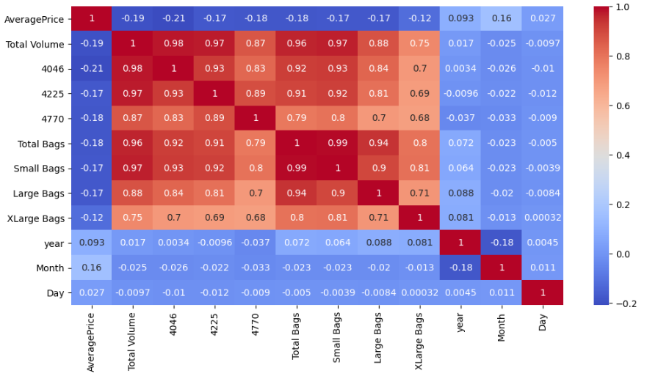
The correlation matrix does not indicate any high degree of correlation with the dependent variable.
However, it does provide us with a holistic view off all the factors.
As we can from the heatmap above, all the Features are not correlated with the
Average Price column, instead most of them are correlated with each other.
So now I am bit worried because that will not help us get a good model.
Let’s try and see.
First, we have to do some Feature Engineering on the categorical Features: region
and type

Slide 8
3. EDA Concluding Remark.
Find patterns of data through visualization and reveal the hidden trends from data.
Using both matplotlib and seaborn library to visualize the data
Finding relationships between features using bar graphs, histograms, box plots, heatmap
Analysing both the numerical and the categorical columns separately
* Data Loading and Description
This data was downloaded and provided by Data trained academy website Avocado Board website in May of 2018 & compiled into a single CSV.
Represents weekly 2018 retail scan data for National retail volume (units) and price.

Slide 9
The dataset comprises of 1517 observations of 35 columns. Below is a table
showing names of all the columns and their description.
The unclear numerical variables terminology is explained in the next section:
Features | Description
Average Price | Its just a useless index feature that will be removed later
‘Total Volume’ | Total sales volume of avocados
‘4046’ | Total sales volume of Small/Medium Hass Avocado
‘4225’ | Total sales volume of Large Hass Avocado
‘4770’ | Total sales volume of Extra-Large Hass Avocado
‘Total Bags’ | Total number of Bags sold
‘Small Bags’ | Total number of Small Bags sold
‘Large Bags’ | Total number of Large Bags sold
‘XLarge Bags’ | Total number of XLarge Bags sold
.

Slide 10
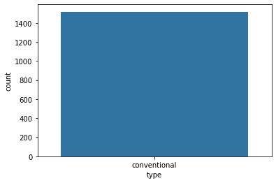
Here type will be the target variable. The dataset is well organised with no missing
values
Target class is imbalance.

Slide 11
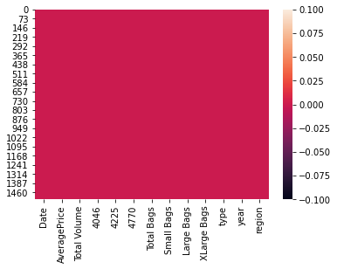
Here heat map contains the null values of the Dataset.
Below I am checking the null values, as find there are no null values in the data set because the red colour is distributed equally correspond to each column
.

Slide 12
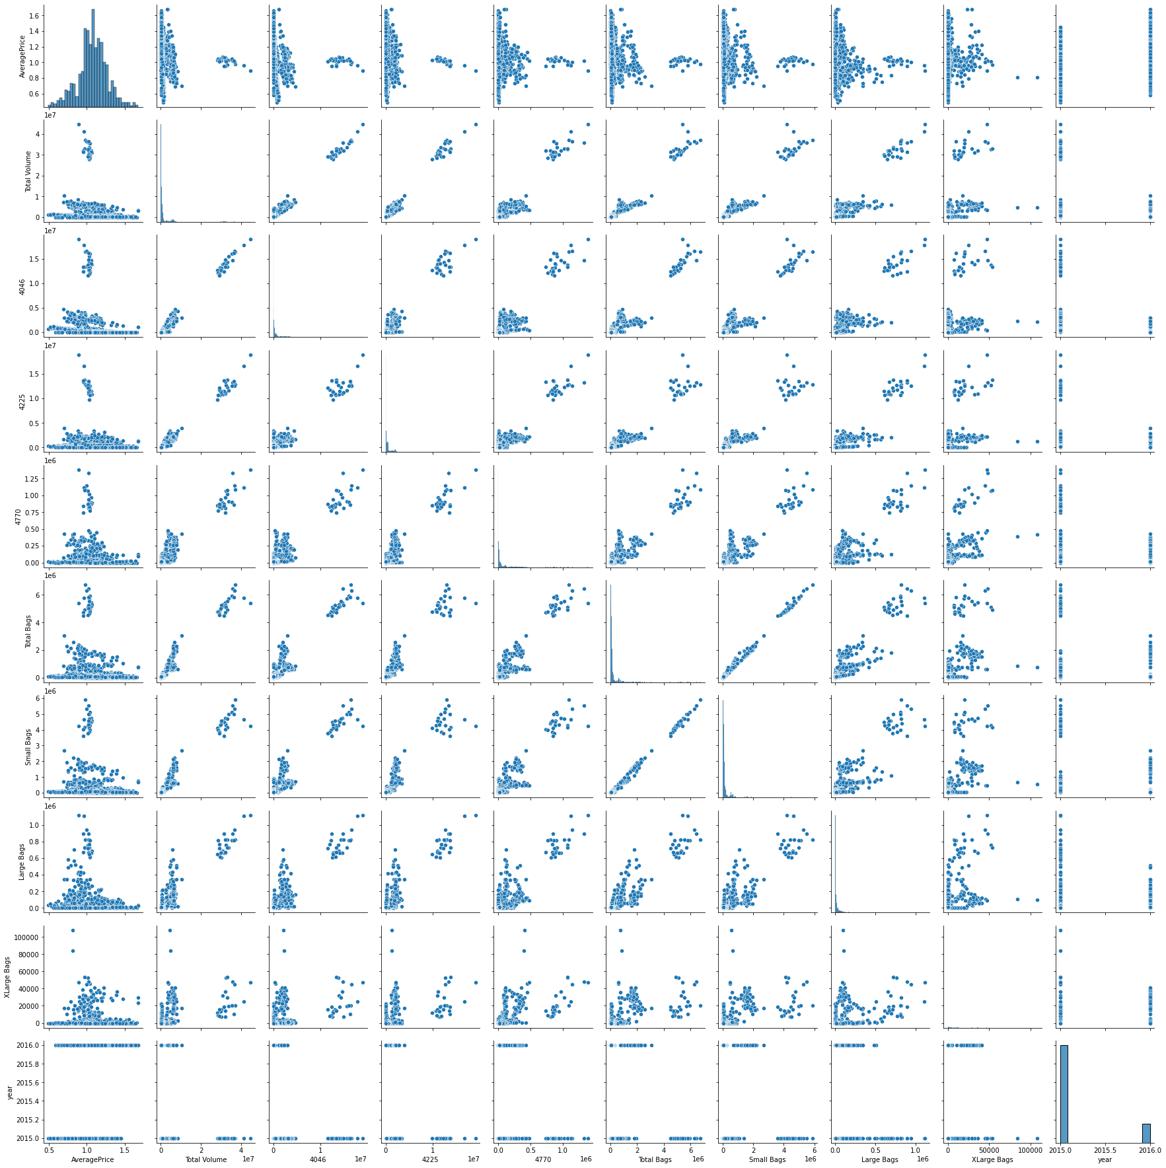
sns. pairplot(df)
Remove the missing values
drop the negativity correlated columns.
remove the outliers.

Slide 13
4. Pre-Processing Pipeline:
Encoding is used to create dummy variables to replace the categories in a categorical variable into features of each category and represent it using 1 or 0 based on the presence or absence of the categorical value in the record.
This is required to do since the machine learning algorithms only work on the numerical data. That is why there is a need to convert the categorical column into a numerical one.
For each of the transformations in Python that has a fit_transform() method , we can wrap them up in an actual pipeline that executes them all in order and even go back and view attributes of each of the transformations. Additionally, you can set parameters for each transformation and the syntax for that is in the link I just shared. If anything, using this pipeline has just cleaned up my code a lot and organized my thinking better

Slide 14
Sklearn provides a very efficient tool for encoding the levels of categorical features into numeric values. Label Encoder encode labels with a value between 0 and n_classes-1 where n is the number of distinct labels. If a label repeats it assigns the same value to as assigned earlier .Convert Region and Type into numeric value by using encoder.
Data has to be pre-processed as machine learning models are better at reading numbers than words. Using label encoding, categorical data can be replaced with numbers. Below code is to display all categorical data.
from sklearn.preprocessing import Label Encoder
LE=Label Encoder()
df["year”] =LE.fit_transform(df["year"])
using the above label encoding method, categorical data can be replaced with number.

Slide 15
5. Building Machine Learning Models.
let’s apply our model which is going to be the Linear Regression because our Target variable 'AveragePrice' is continuous.
Let's now begin to train out regression model We will need to first split up our data into an X array that contains the target variable, and a y array with the target variable.
x=df. drop(["AveragePrice"], axis=1)
y=df["AveragePrice"]
x_train, x_test, y_train, y_test=train_test_split (x, y, random_state=50, test_size=0.2)
Here we can use Regression method to build the models
DecisionTreeRegressor
LogisticRegression
RandomForestRegressor

Slide 16
I had done this prediction by taking Average price as an output variable which is continuity in nature so that why I’m using the regression technique
While calculating the best random state the 80 is best state which providing the highest R2 score value for this model.
After using the GridSeachCV, I can find the best param and then I used these param for that model.
There are following matrices which I find, and which are providing the best score.
I also plot the scatter plot graph and we can see that the actual value and predicted values are very close to each other, so the line is best fit line.
I am finding the score by taking region as an y value, I am using Regressor method because the region data is categorical in nature, so I am importing the Regressor model and their matrices.
According to the Regressor report the accuracy of the model is 63% however its recall is lower at 15% of positive cases.The DecisionTreeRegressor model is providing excellent results, however the purpose of the problem is to identify fruits that are likely to leave. This is the reason that accuracy then becomes a very important measure. Accuracy measures the fraction of values that are identified correctly.

Slide 17
The highest final model of the dataset: In the end, we can see that utilizing data science on AveragePrice provided significant benefit to the business as we can tag each fruit with the averages price and come up with customized Avacado retention strategy for each group.
Decision Tree Classifier has emerged as the final winning model with 63% and highest. This could
be the highestpossible score achieved with the inherent limitations in the dataset.
Here Decision Tree Regressor is the best model.
Machine learning models are as good as the data to feed it, and more data would strengthen the model. For example, in this dataset, the feature ‘Performance Rating’ has been restricted to scores of 3 and 4 only. More insights could be generated if the full spectrum of performance ratings is included. In the real-life situation, getting the right data is often more challenging than the analytics itself.

Slide 18
6. Concluding Remarks.
With the help of notebook I learnt how EDA can be carried out using Pandas and other plotting libraries.
Also, I have seen making use of packages like matplotlib, plotly and seaborn to develop better insights about the data.
I have also seen how preproceesing helps in dealing with missing values and irregualities present in the data. I also learnt how to create new features which will in turn help us to better predict the survival.
I also make use of pandas profiling feature to generate an html report containing all the information of the various features present in the dataset.
I have seen the impact of columns like type, year/date on the Average price increase/decrease rate.

Slide 19
In this project the trend and periodity of avocado price and sales volume time
series and also analysed their association .we extracted monthly and annual
patterns from the spectrum density analysis ,and also determined the trend of price
variation from the spectrum decomposition ,which is not constantly increasing but
shows a decreasing trend in recent years.in addition,we applied a regression on the
price and sales volume time series and discovered a negative correlation between
the two time series. Which is consistent with our empirical knowledge.
The visualisation we were dreaming of at the beginning of this project has now
become a reality.

